Slide 1

6th Grade Accelerated Math
Unit 11, Lesson 8 Evaluating Numeric Expressions – Part 1 Volume 2, pg. 199

Slide 2


Benchmarks
MA.7.NSO.2.1
Solve mathematical problems using multi‑step order of operations with rational numbers including grouping symbols, whole-number exponents, and absolute value.
MA.7.NSO.2.2
Add, subtract, multiply, and divide rational numbers with procedural fluency.
volume 2, pg. 199

Slide 3
Integrated Mathematical Thinking and Reasoning Standards
MA.K12.MTR.1.1 Actively participate in effortful learning both individually and collectively.
MA.K12.MTR.3.1 Complete tasks with mathematical fluency.
MA.K12.MTR.4.1 Engage in discussions that reflect on the mathematical thinking of self and others.
MA.K12.MTR.5.1 Use patterns and structure to help understand and connect mathematical concepts.
MA.K12.MTR.6.1 Assess the reasonableness of solutions.
volume 2, pg. 199

Slide 4

Learning Target
I can evaluate numeric expressions with up to four operations.
volume 2, pg. 199

Slide 5

Warm-Up
volume 2, pg. 200

Slide 6
11.8.1 Warm-Up: Math Symbols
In the 18th century, Robert Recorde decided to use a symbol for the idea of “is equal to” so he would not have to write the words over and over. As more mathematicians also began to use the symbol, the “=” became accepted as the standard symbol for equality. Math is full of symbols that shorten lengthy words and calculations. But just like symbols you use when communicating with others, like “LOL” in texting, once you learn their meaning, understanding the mathematics is not so challenging.
volume 2, pg. 200

Slide 7
List math symbols that you are familiar with and what they represent.
List other math symbols you have seen before, but you are unfamiliar with.
volume 2, pg. 200

Slide 8

Guided Instruction
volume 2, pg. 200

Slide 9
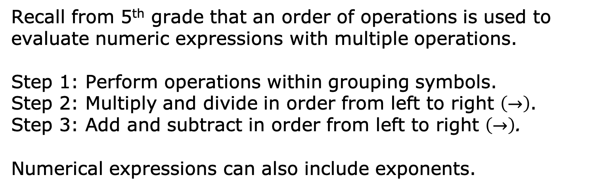
11.8.2 Guided Instruction: Applying the Order of Operations for Expressions Including Exponents
Recall from 5th grade that an order of operations is used to evaluate numeric expressions with multiple operations.
Step 1: Perform operations within grouping symbols.
Step 2: Multiply and divide in order from left to right $\left(→\right)$.
Step 3: Add and subtract in order from left to right $\left(→\right)$.
Numerical expressions can also include exponents.
volume 2, pg. 200

Slide 10

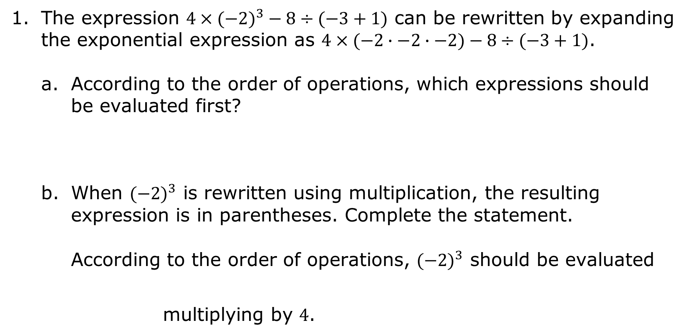
The expression ${4×(−2)}^{3}−8÷(−3+1)$ can be rewritten by expanding the exponential expression as $4×(−2∙−2∙−2)−8÷(−3+1)$.
According to the order of operations, which expressions should be evaluated first?
When ${(−2)}^{3}$ is rewritten using multiplication, the resulting expression is in parentheses. Complete the statement.
According to the order of operations, ${(−2)}^{3}$ should be evaluated multiplying by $4$.
volume 2, pg. 200

Slide 11
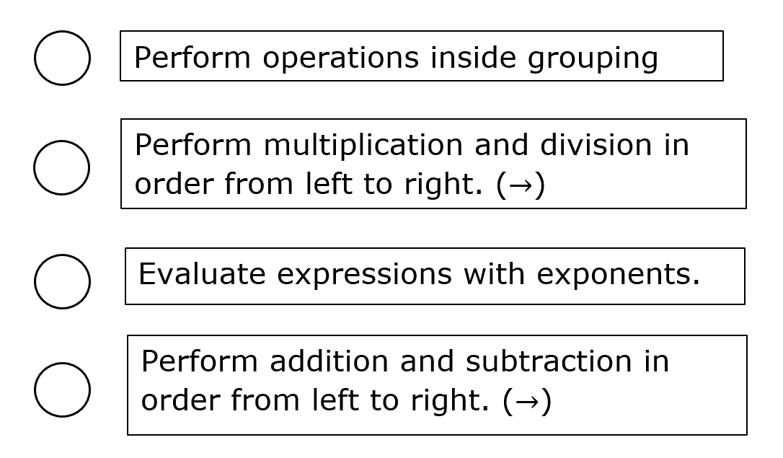
Work with your partner to number each operation so that the order of operations is in the correct order.
volume 2, pg. 201

Slide 12
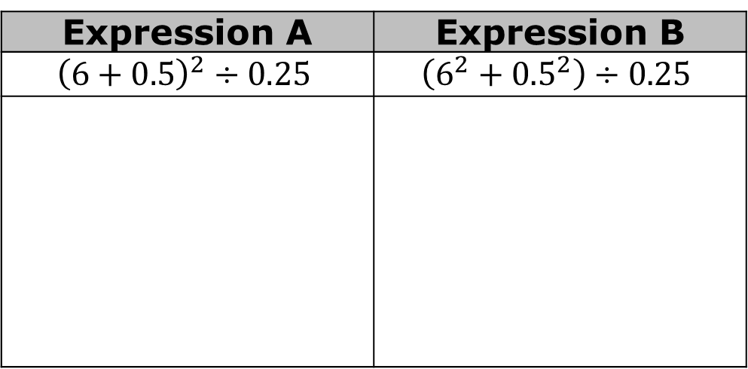
Use order of operations to evaluate one of the expressions shown in the table below while your partner evaluates the other expression.
How are the problems similar?
How are the problems different?
Expression A | Expression B
$${\left(6+0.5\right)}^{2}÷0.25$$ | $$\left(6^{2}+{0.5}^{2}\right)÷0.25$$
volume 2, pg. 201

Slide 13
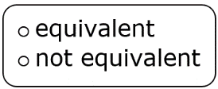
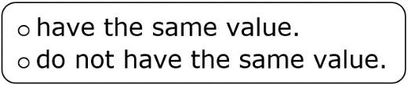
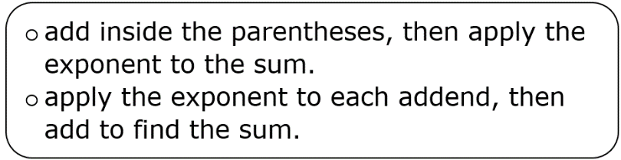
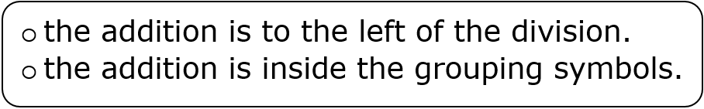
Complete the statements about the expressions.
The two expressions are because they
For Expression A, first
For Expression B, first
For both expressions, addition was done before division because
volume 2, pg. 201

Slide 14


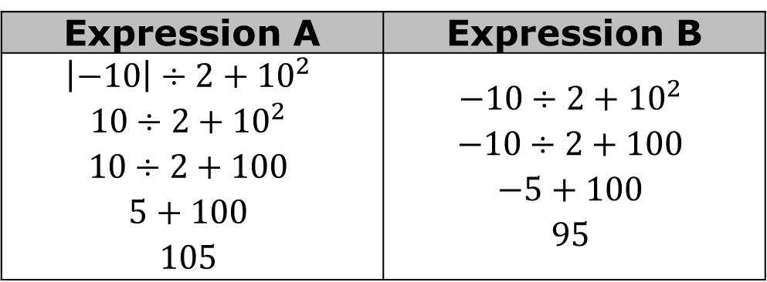
Anna evaluated Expression A and Expression B. Her work is shown.
Anna’s partner gave her a on both of her answers. Why did Anna arrive at two different values when evaluating these similar looking expressions?
Expression A | Expression B
$${\left|−10\right|÷2+10}^{2}$$ $${10÷2+10}^{2}$$ $$10÷2+100$$ $$5+100$$ $$105$$ | $${−10÷2+10}^{2}$$ $$−10÷2+100$$ $$−5+100$$ $$95$$
Absolute value notation should be treated the same as grouping symbols when following the order of operations.
volume 2, pg. 202

Slide 15
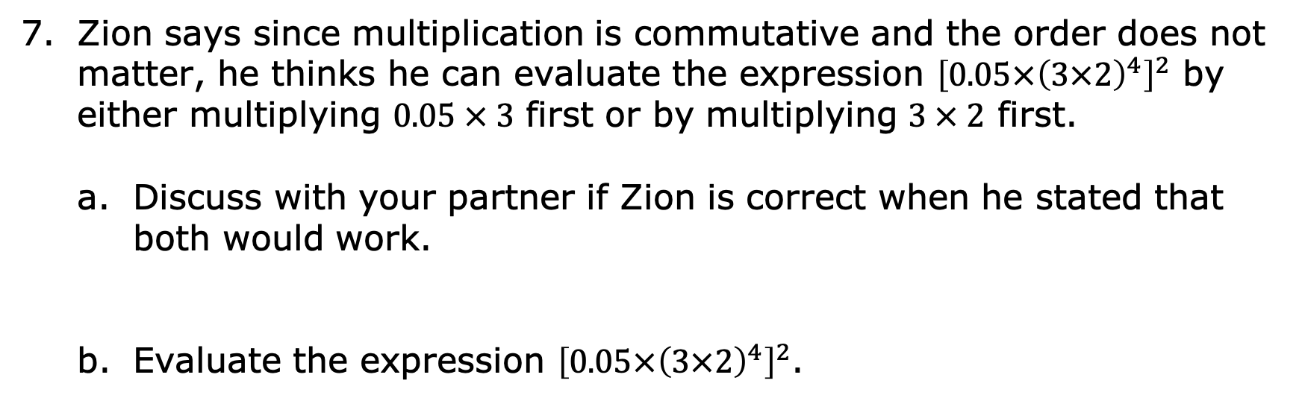
Zion says since multiplication is commutative and the order does not matter, he thinks he can evaluate the expression ${\left[0.05×{\left(3×2\right)}^{4}\right]}^{2}$ by either multiplying $0.05 × 3$ first or by multiplying $3 × 2$ first.
Discuss with your partner if Zion is correct when he stated that both would work.
Evaluate the expression ${\left[0.05×{\left(3×2\right)}^{4}\right]}^{2}$.
When using the order of operations to evaluate an expression with nested grouping symbols, apply the order of operations inside the inner grouping symbols first.
volume 2, pg. 202

Slide 16

Collaboration
volume 2, pg. 203

Slide 17

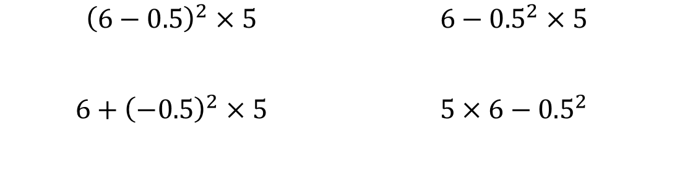
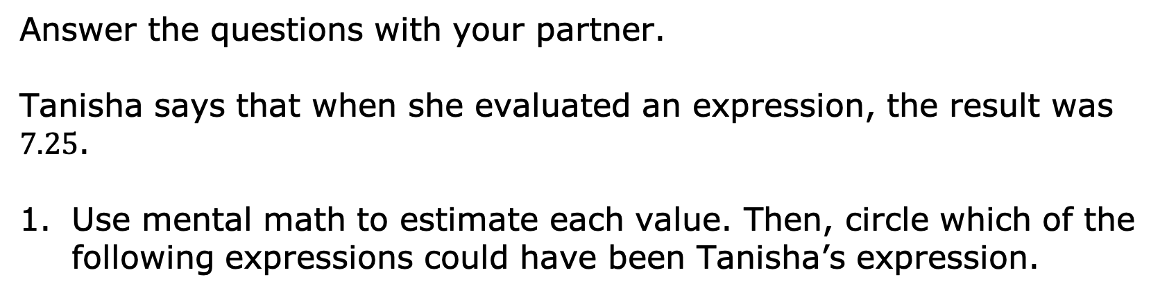
11.8.3 Collaboration: Determining Equivalent Expressions
Answer the questions with your partner.
Tanisha says that when she evaluated an expression, the result was $7.25$.
Use mental math to estimate each value. Then, circle which of the following expressions could have been Tanisha’s expression.
$${\left(6−0.5\right)}^{2}×5$$ | $${6−0.5}^{2}×5$$
$${6+\left(−0.5\right)}^{2}×5$$ | $$5×6−{0.5}^{2}$$
volume 2, pg. 203

Slide 18
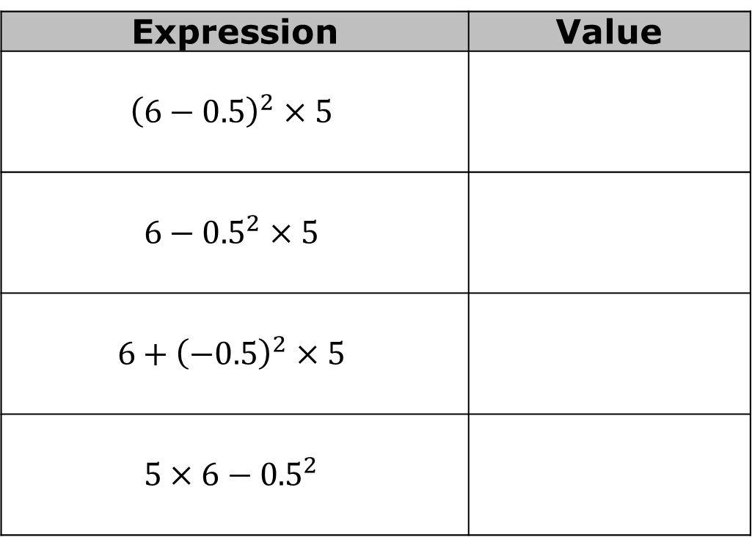
Find the values of the expressions to verify your choice.
Expression | Value
$${\left(6−0.5\right)}^{2}×5$$
$${6−0.5}^{2}×5$$
$${6+\left(−0.5\right)}^{2}×5$$
$$5×6−{0.5}^{2}$$
volume 2, pg. 203

Slide 19

Exploration
volume 2, pg. 203

Slide 20

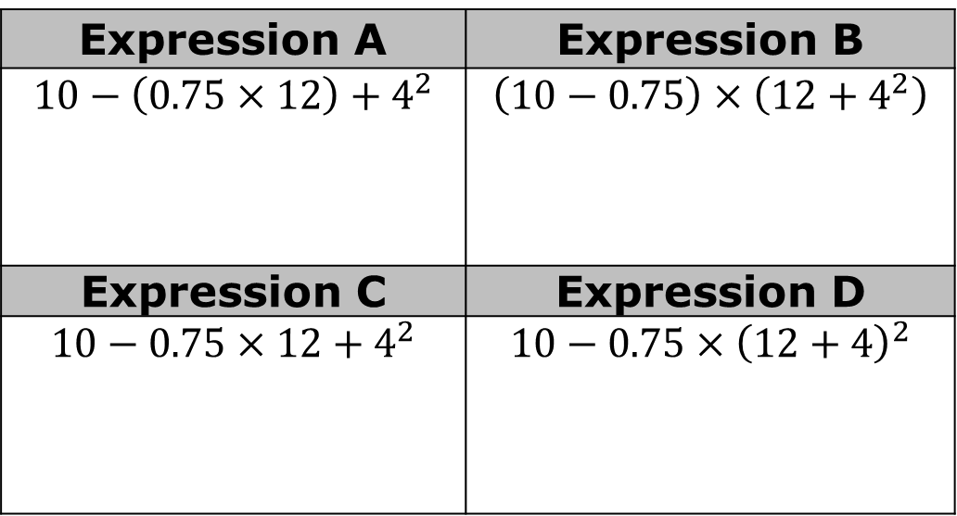
11.8.4 Exploration: Grouping Symbols
Without working the problems, discuss with your partner which expression in the table you expect to have the largest value.
Expression A | Expression B
$$10−\left(0.75×12\right)+4^{2}$$ | $$\left(10−0.75\right)×\left(12+4^{2}\right)$$
Expression C | Expression D
$$10−0.75×12+4^{2}$$ | $$10−0.75×{\left(12+4\right)}^{2}$$
volume 2, pg. 203

Slide 21
Put an asterisk (*) next to the expression you expect will have the largest value. Write your explanation here.
Evaluate each of the expressions in the table with your partner.
volume 2, pg. 203

Slide 22
With another set of partners, share if your guess was or was not correct. Discuss how the order of operations affected the value of your guesses. Summarize your discussion.
For the two expressions in the table that resulted in the same value, explain why they have the same value.
volume 2, pg. 204

Slide 23

Your Turn
volume 2, pg. 204

Slide 24

11.8.5 Your Turn!
Evaluate each expression without using a calculator.
${\left[\left(10−15\right)×2\right]}^{3}+50$
${\left(2^{4}−3×6\right)}^{2}$
${\left|18+\left(−2\right)×14\right|}^{5}$
volume 2, pg. 204

Slide 25

${\left[{0.8×\left(1.2+2.8\right)}^{2}\right]}^{2}$
$\left[{\left(0.8×10\right)}^{2}+4.5\right]÷0.5$
${\left(10×0.4\right)}^{2}+\left(28.4÷\left(−4\right)\right)$
volume 2, pg. 204

Slide 26

Wrap-Up
volume 2, pg. 205

Slide 27
11.8.6 Wrap-Up: Reflection
Complete each statement based on your learning today.
A barrier to my learning was …
I will try to overcome this by …
Today I am still unsure about …
To fill in this gap I intend to …
volume 2, pg. 205

